Slide 1
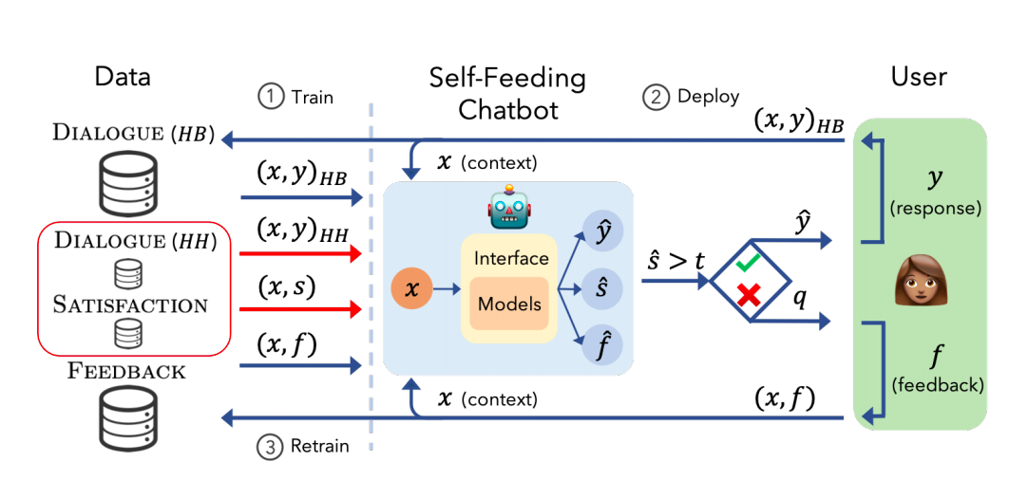
AI moderation of chatbot feed using intent classification and entity recognition for Higher Education Support System
Presented by
T.Nagaraju

Slide 2




Abstract
ChatBot can be known as a tool that can interact with humans using artificial intelligence.
feeding the next generation of bots using intent classification and entity recognition
An AI chatbot learns right from scratch through a process called “Deep Learning”.

Slide 3
Introduction
AI tools are used used to perform tasks such as quickly responding to users, informing them, helping to purchase products and providing better service to customers.
a human-to-human conversation is the preferred way to create the best possible deep learning chatbot.
Note, the more data you have, the better the effectiveness of machine learning will be.

Slide 4
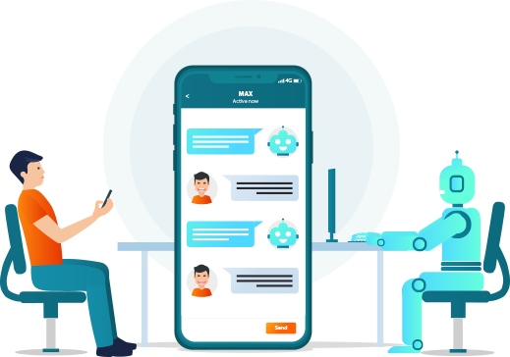
What is ChatBot

Slide 5
AI Chat Boats
Traditional
Rule-based Chat
Boats
Rule-based bots have a less flexible conversational flow
AI chatbots that use machine learning understand the context and intent of a question before formulating a response.

Slide 6
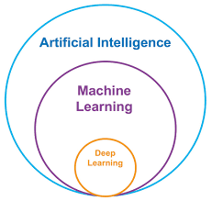
AI
Approaches

Slide 7
Objective
To study and analyze the Machine Learning algorithms to moderate input data.
Design and analyze the efficient machine Learning algorithm for prediction human queries.
Implement an algorithm for prediction of responses in order to reduce the overall delay that occur due to large data input processing.

Slide 8
Problem Statement
AI moderation of chatbot feed using intent classification and entity recognition

Slide 9
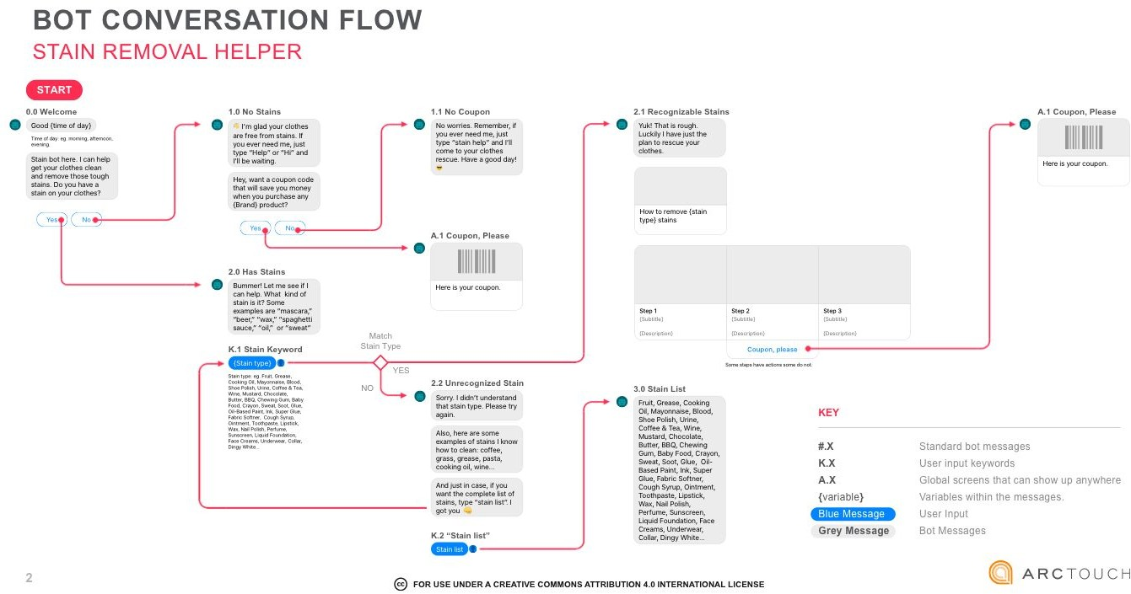
Workflow

Slide 10
Technologies used
Python

Slide 11
Conclusion
Identifying the processing of raw input data of client information will help in the long term serving of chatbots.
chatbots response prediction is challenging and very important in every field as several factors.
The chatbot is trained to develop its own consciousness on the text,voice,image and you can teach it how to converse with people.

Slide 12
References
Eishvak Sengupta, Dhruv Garg, Tanupriya Choudhury, Archit Aggarwal, "Techniques to Elimenate Human Bias in Machine Learning", System Modeling & Advancement in Research Trends (SMART) 2018 International Conference on, pp. 226-230, 2018.
Satyendra Praneel Reddy Karri, B. Santhosh Kumar, "Deep Learning Techniques for Implementation of Chatbots", Computer Communication and Informatics (ICCCI) 2020 International Conference on, pp. 1-5, 2020.
Sangeeta Kumari, Zaid Naikwadi, Akshay Akole, Purushottam Darshankar, "Enhancing College Chat Bot Assistant with the Help of Richer Human Computer Interaction and Speech Recognition", Electronics and Sustainable Communication Systems (ICESC) 2020 International Conference on, pp. 427-433, 2020.

Slide 13


